Slide 1
Serializability in DBMS

Slide 2
Serializability
Serializability of schedules ensures that a non-serial schedule is equivalent to a serial schedule.
It helps in maintaining the transactions to execute simultaneously without interleaving one another.
In simple words, serializability is a way to check if the execution of two or more transactions are maintaining the database consistency or not.

Slide 3
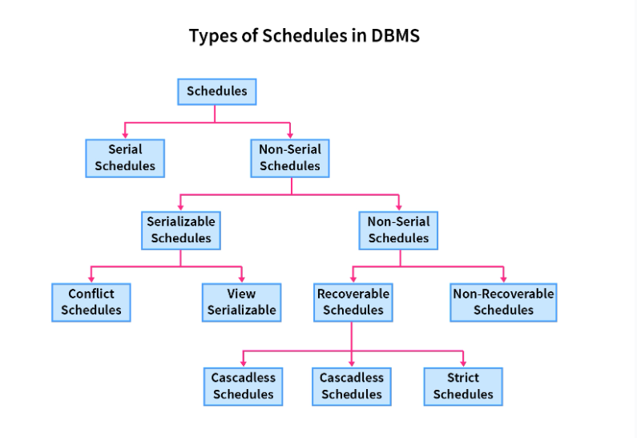
Schedules and Serializable Schedules in DBMS

Slide 4
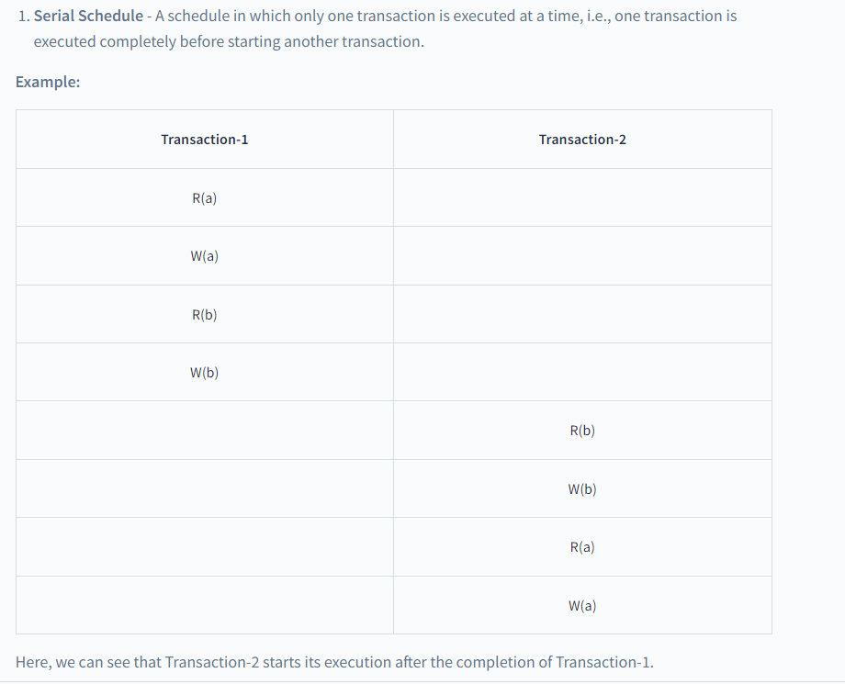
Schedules and Serializable Schedules in DBMS

Slide 5
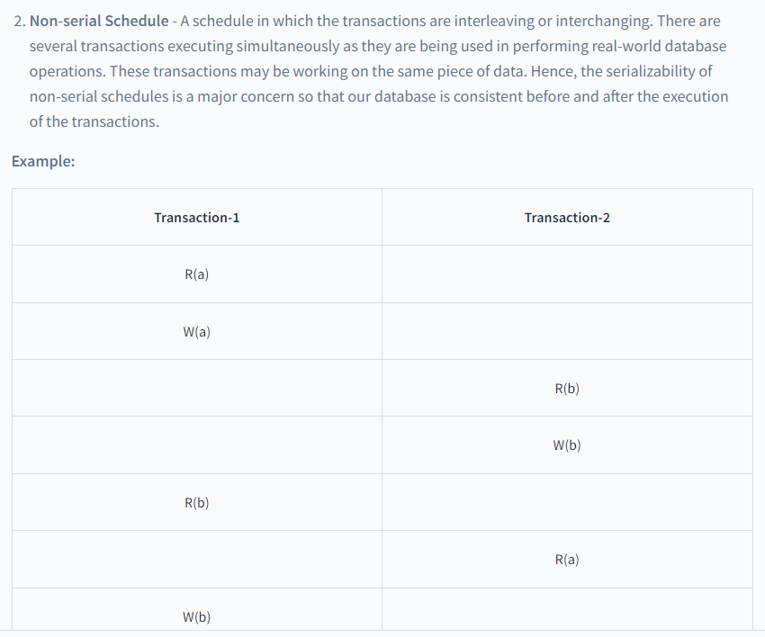
Schedules and Serializable Schedules in DBMS

Slide 6
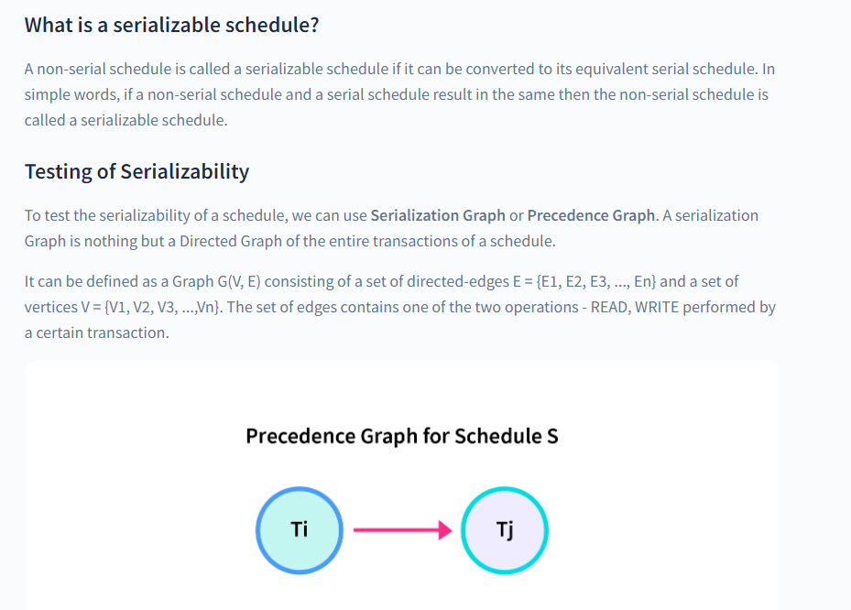
Schedules and Serializable Schedules in DBMS

Slide 7
If there is a cycle present in the serialized graph then the schedule is non-serializable
The cycle resembles that one transaction is dependent on the other transaction and vice versa.
It also means that there are one or more conflicting pairs of operations in the transactions.
On the other hand, no-cycle means that the non-serial schedule is serializable.

Slide 8
Conflicting pair in transactions?
Two operations inside a schedule are called conflicting if they meet these three conditions:
They belong to two different transactions.
They are working on the same data piece.
One of them is performing the WRITE operation.
To conclude, let’s take two operations on data: "a".
The conflicting pairs are:
READ(a) - WRITE(a)
WRITE(a) - WRITE(a)
WRITE(a) - READ(a)

Slide 9
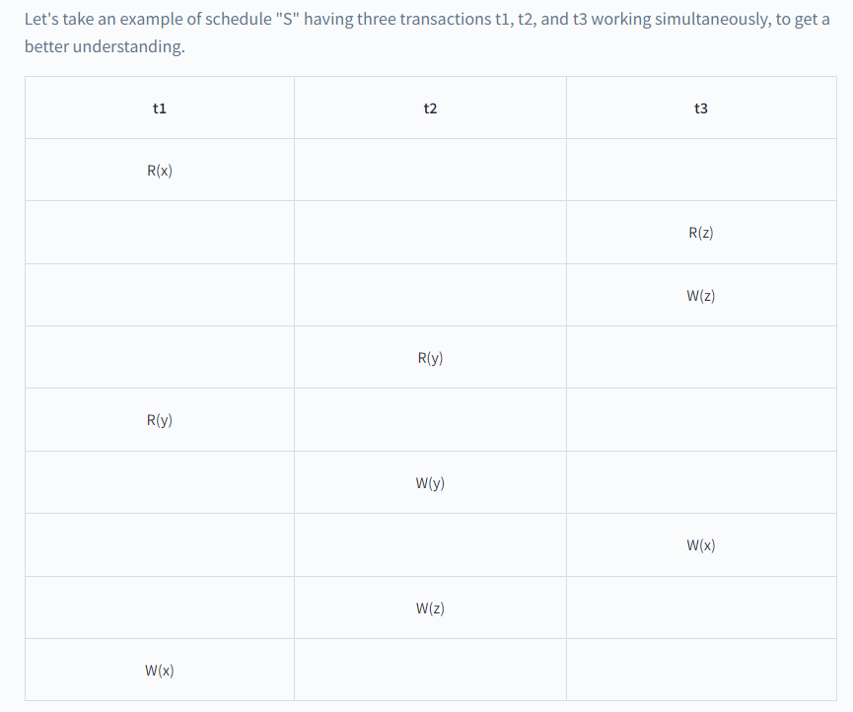

Slide 10
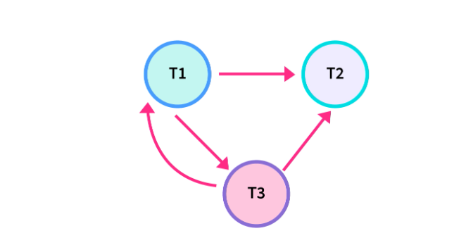
Non-serializable schedule. R(x) of T1 conflicts with W(x) of T3, so there is a directed edge from T1 to T3. R(y) of T1 conflicts with W(y) of T2, so there is a directed edge from T1 to T2. W(y\x) of T3 conflicts with W(x) of T1, so there is a directed edge from T3 to T. Similarly, we will make edges for every conflicting pair. Now, as the cycle is formed, the transactions cannot be serializable.

Slide 11
Types of Serializability
Serializability of any non-serial schedule can be verified using two types mainly:
Conflict Serializability and
View Serializability.
One more way to check serializability is by forming an equivalent serial schedule that results in the same as the original non-serial schedule.

Slide 12
Conflict Serializability and Conflict Serializable Schedules
A non-serial schedule is a conflict serializable if, after performing some swapping on the non-conflicting operation results in a serial schedule. It is checked using the non-serial schedule and an equivalent serial schedule.
we will check conflicting pairs operations(read-write, write-read, and write-write) and then form directed edges between those conflicting pair transactions. If we can find a loop in the graph, then the schedule is non-conflicting serializable otherwise it is surely a conflicting serializable schedule.

Slide 13
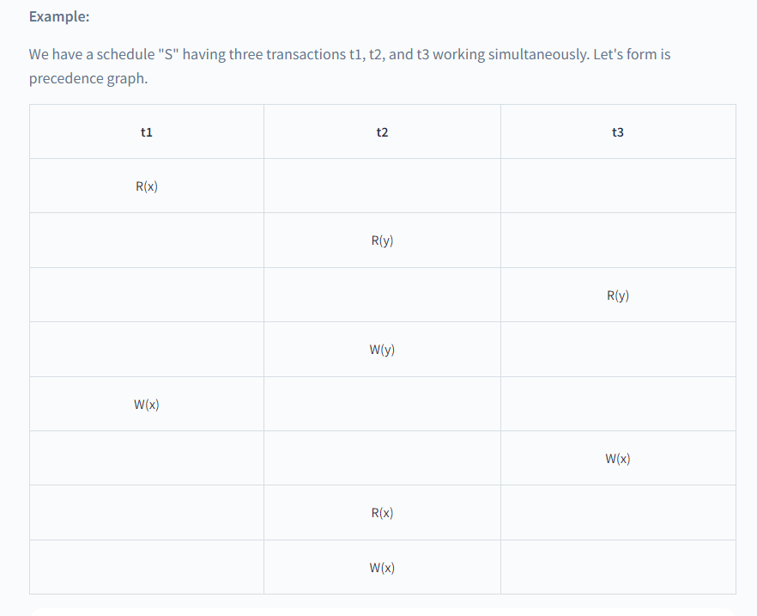
Conflict Serializability and Conflict Serializable Schedules

Slide 14
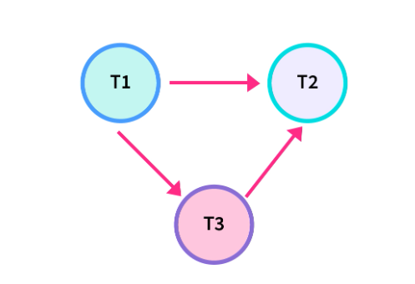

Slide 15
As there is no loop in the graph, it is a conflict serializable schedule as well as a serial schedule. Since it is a serial schedule, we can detect the order of transactions as well.
The order of the Transactions: t1 will execute first as there is no incoming edge on T1. t3 will execute second as it depends on T1 only. t2 will execute at last as it depends on both T1 and T3.
So, order of its equivalent serial schedule is: t1 --> t3 --> t2

Slide 16
If a schedule is conflicting serializable, then it is surely a consistent schedule. On the other hand, a non-conflicting serializable schedule may or may not be serial. To further check its serial behavior, we use the concept of View Serializability.
A conflict serializable schedule is always viewed as serializable, but vice versa is not always true.

Slide 17
View Serializability and View Serializable Schedules
If a non-serial schedule is view equivalent to some other serial schedule then the schedule is called View Serializable Schedule. It is needed to ensure the consistency of a schedule.

Slide 18
View Equivalency
The two conditions needed by schedules(S1 and S2) to be view equivalent are:
Initial read must be on the same piece of data.
Example: If transaction t1 is reading "A" from database in schedule S1, then in schedule S2, t1 must read A.
Final write must be on the same piece of data.
Example: If a transaction t1 updated A at last in S1, then in S2, t1 should perform final write as well.
The mid sequence should also be in the same order.
Example: If t1 is reading A which is updated by t2 in S1, then in S2, t1 should read A which should be updated by t2.
This process of checking view equivalency of a schedule is called View Serializability.

Slide 19
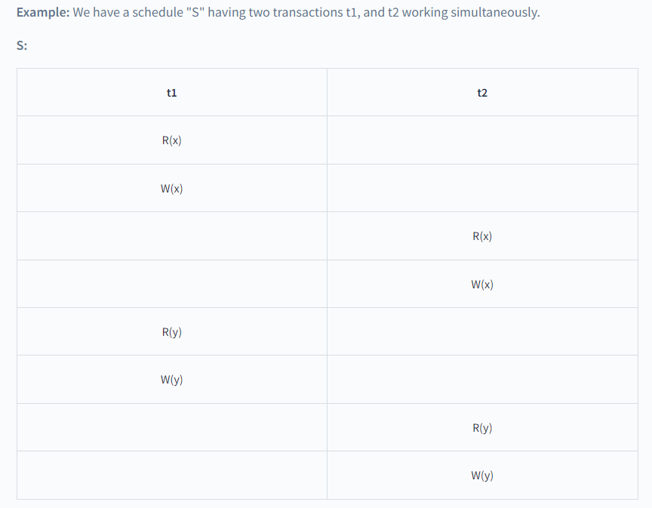

Slide 20
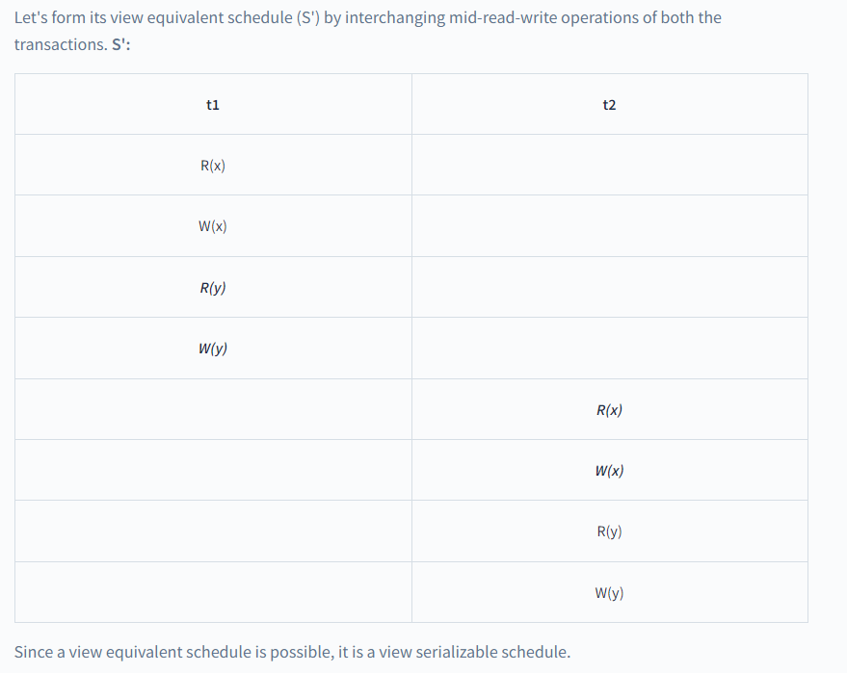

Slide 21
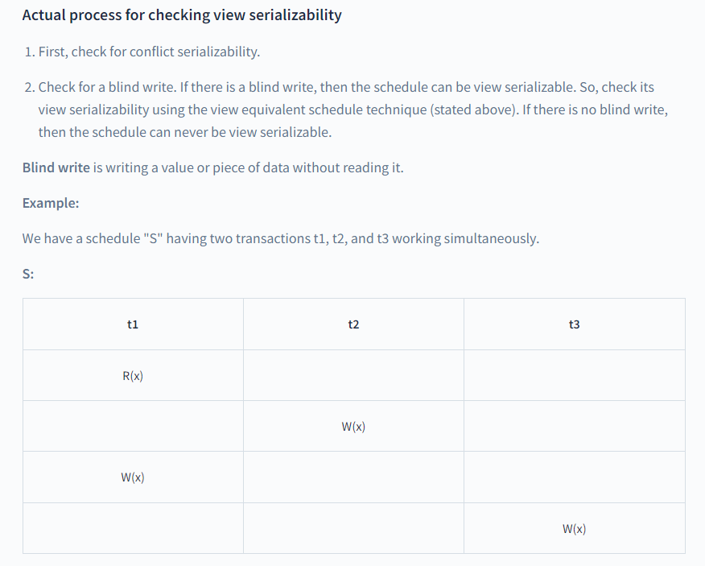

Slide 22
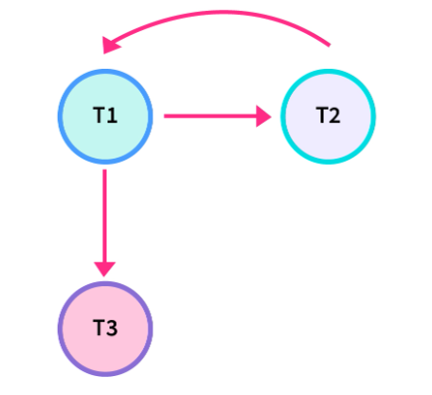

Slide 23
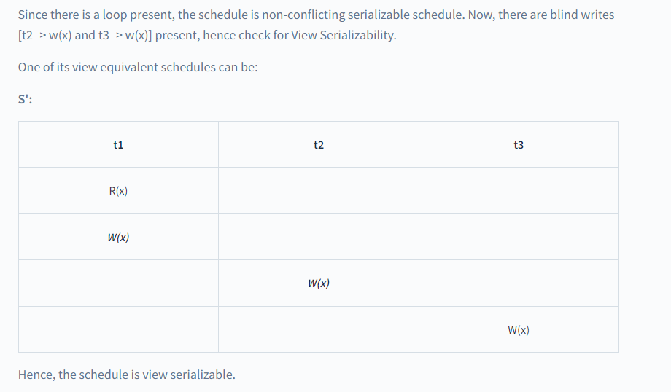

Slide 24
One important thing to note here is that we can form a number of sequences of the transactions such as:
t1 t2 t3
t1 t3 t2
t2 t1 t3
t2 t3 t1
t3 t1 t2
t3 t2 t1
This makes it a N-P Hard problem.

Slide 25
Advantages of Serializability
Serialization helps in checking concurrency control between multiple transactions. It also helps in maintaining consistency in the database before and after any transaction. Serializable schedules are resource-efficient and help in improving CPU throughput(total work done in a certain time).
Serialization is a way to check if the execution of two or more transactions is maintaining the database consistency or not.
Serialization helps to maintain isolation between multiple transactions under a schedule.

Slide 26
Problem-01:
Check whether the given schedule S is conflict serializable or not-
S : R₁(A) , R₂(A) , R₁(B) , R₂(B) , R₃(B) , W₁(A) , W₂(B)
Solution-
Step-01:
List all the conflicting operations and determine the dependency between the transactions-
R₂(A) , W₁(A) (T₂ → T₁)
R₁(B) , W₂(B) (T₁ → T₂)
R₃(B) , W₂(B) (T₃ → T₂)

Slide 27
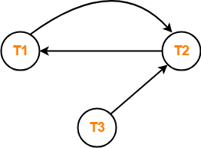
Problem-01:

Slide 28
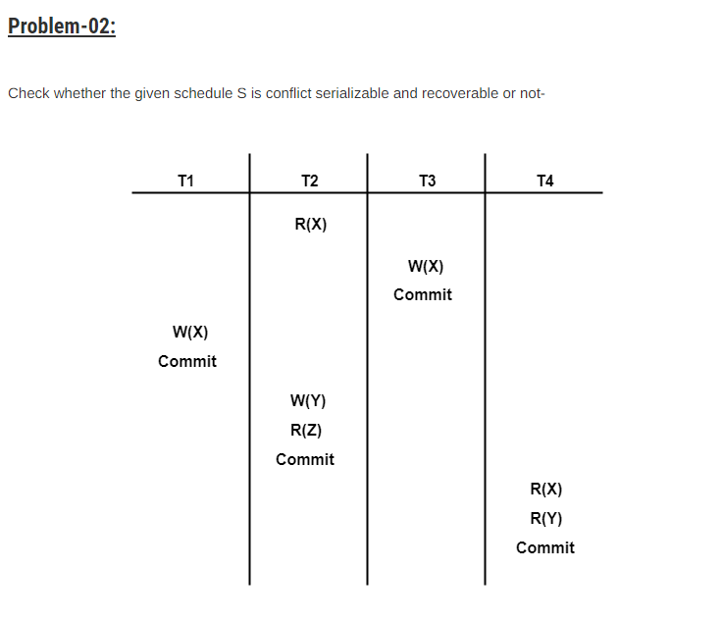

Slide 29
List all the conflicting operations and determine the dependency between the transactions-
R₂(X) , W₃(X) (T₂ → T₃)
R₂(X) , W₁(X) (T₂ → T₁)
W₃(X) , W₁(X) (T₃ → T₁)
W₃(X) , R₄(X) (T₃ → T₄)
W₁(X) , R₄(X) (T₁ → T₄)
W₂(Y) , R₄(Y) (T₂ → T₄)

Slide 30

